Slide 1









Benchmarking Large Language Models on CMExam - A Comprehensive Chinese Medical Exam Dataset
Junling Liu†*, Peilin Zhou*, Yining Hua*, Dading Chong, Zhongyu Tian, Andrew Liu, Helin Wang, Chenyu You, Zhenhua Guo, Lei Zhu, Michael Lingzhi Li

Slide 2
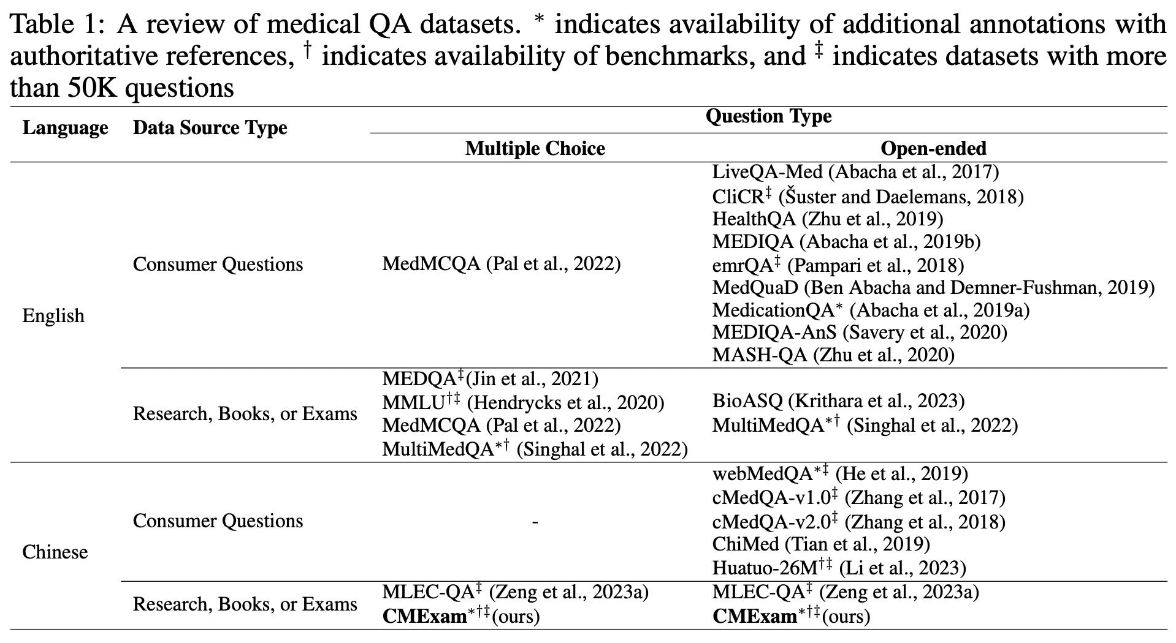
Challenge of evaluating LLMs in medical fields
Insufficient size and diversity
Lack clear choice evaluations
Lack explanations
Unreliable sources
Language resource inequality

Slide 3
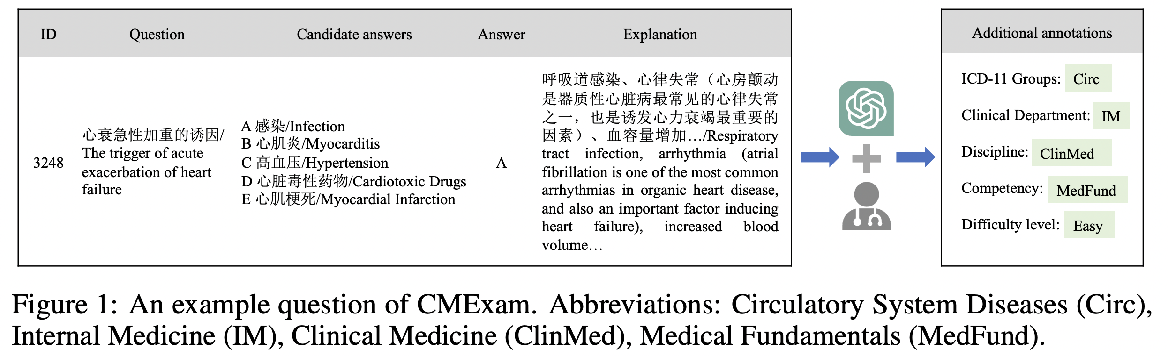

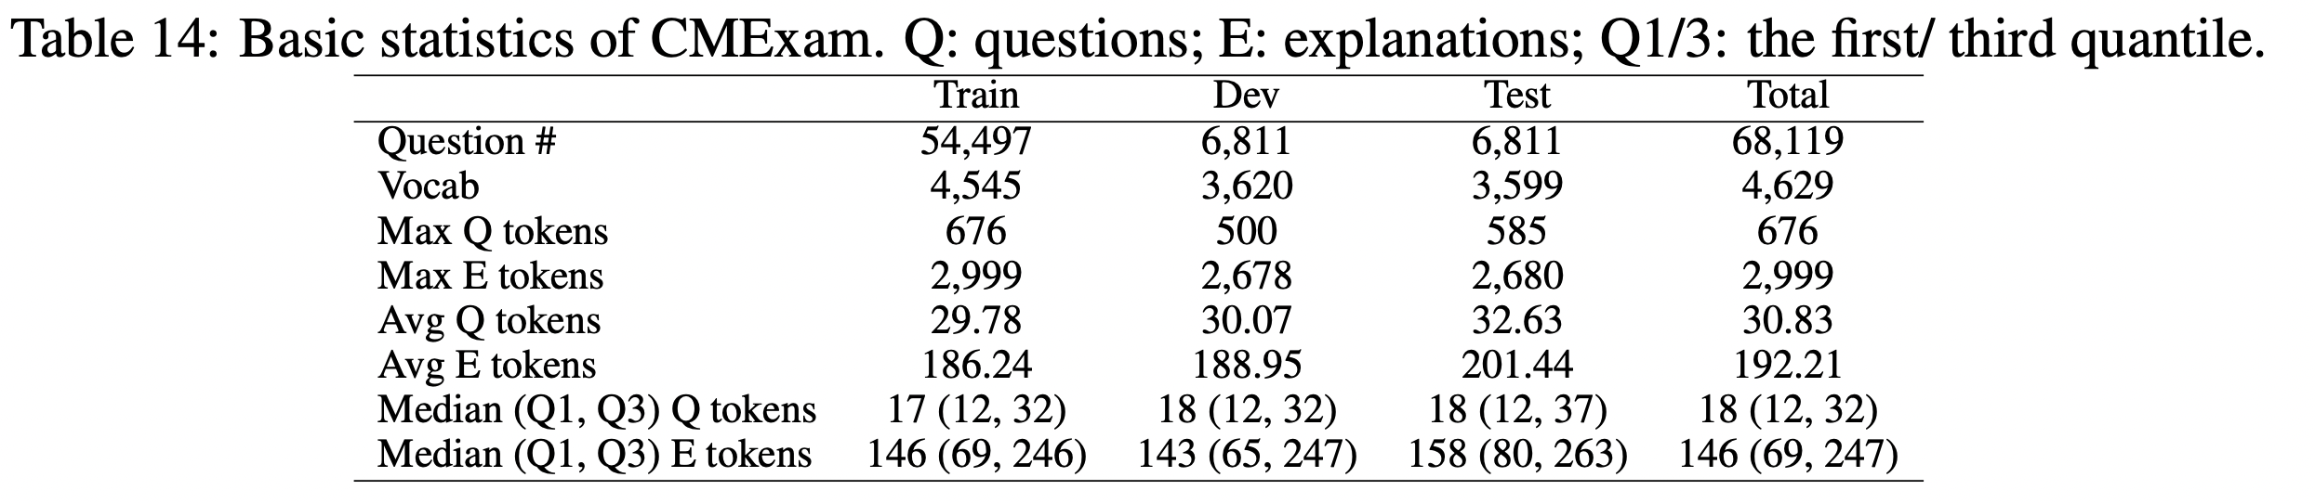
CMExam
60K+ QA pairs
Five Additional Annotations
Disease Groups
Clinical Departments
Medical Disciplines
Areas of Competency
Question Difficulty Levels
Corresponding Explanation

Slide 4
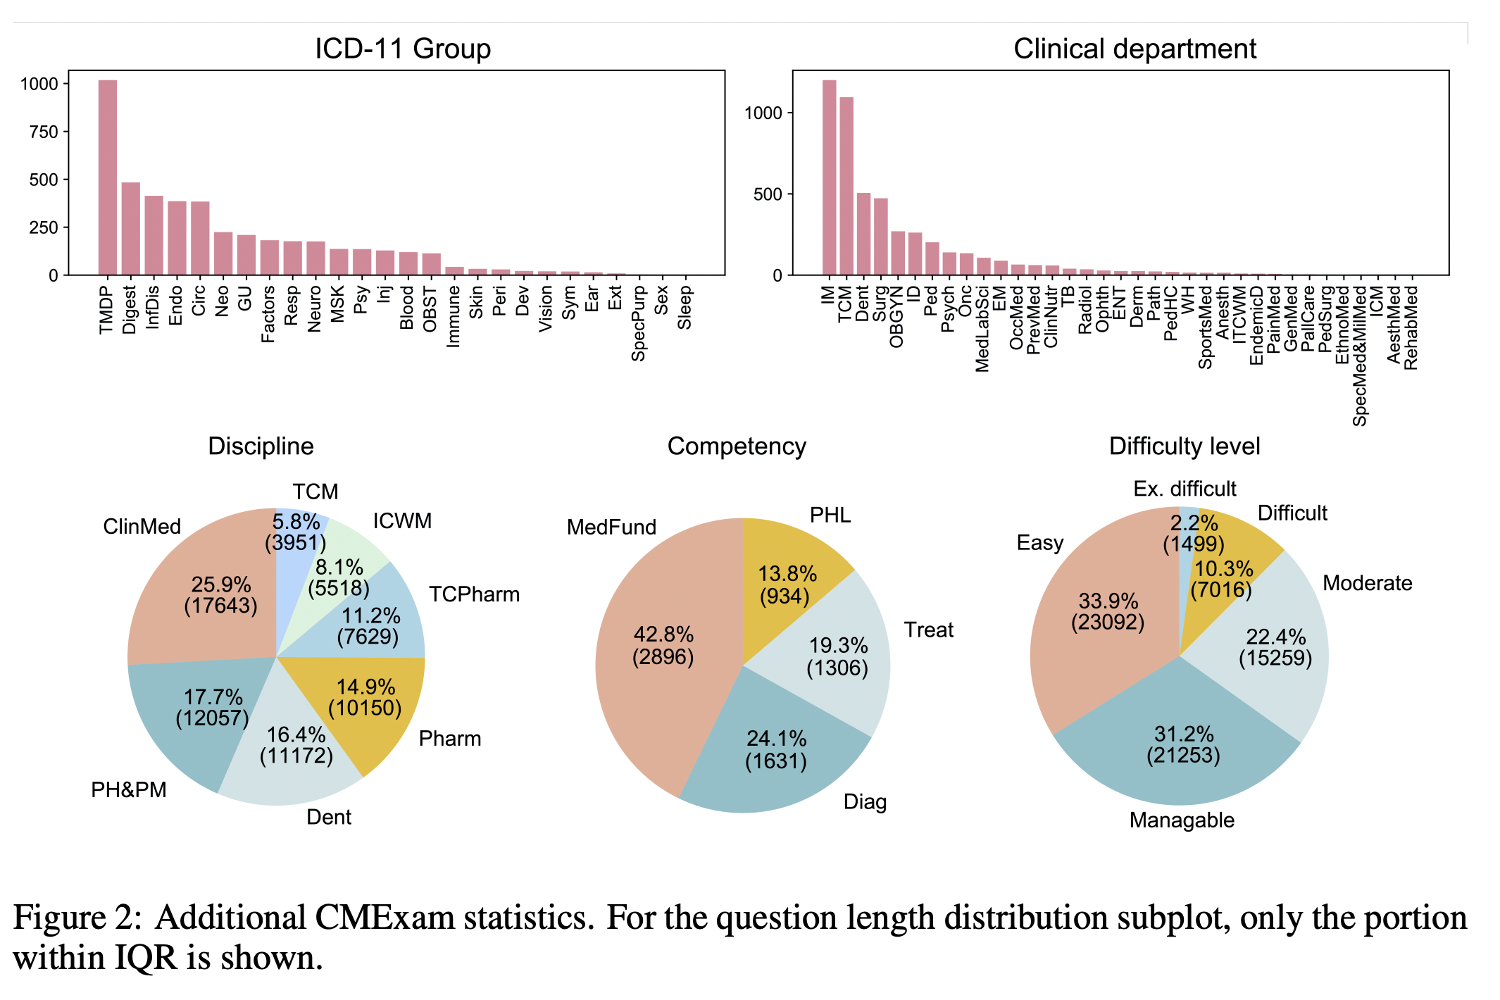
Additional annotations

Slide 5
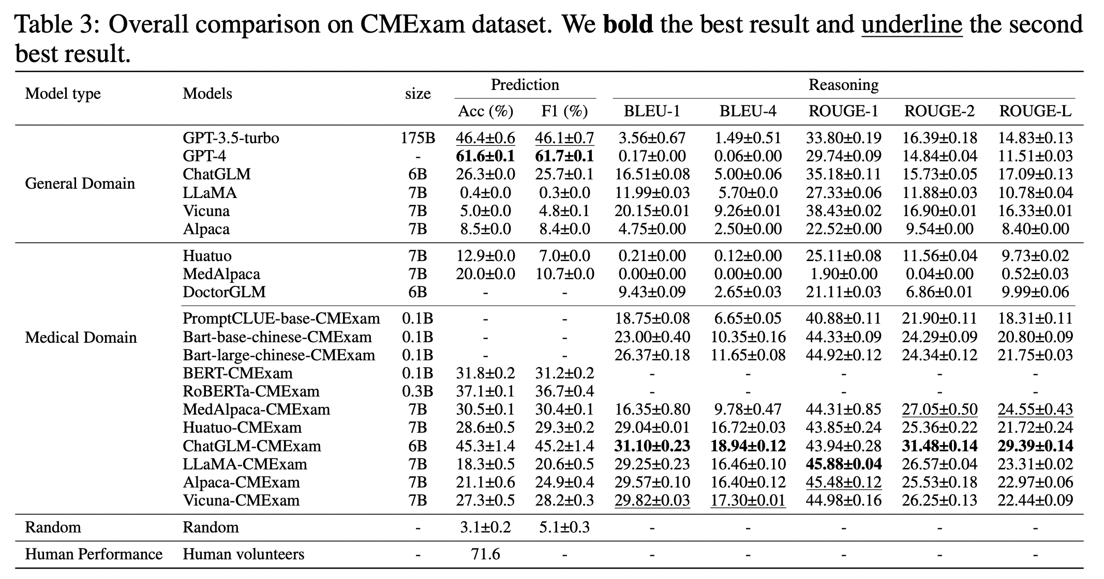
Benchmarking on CMExam
Model Type
General Domain
Medical Domain
Tasks
Answer Prediction
Answer Reasoning
Methods
Zero-shot
Supervised Finetuning

Slide 6
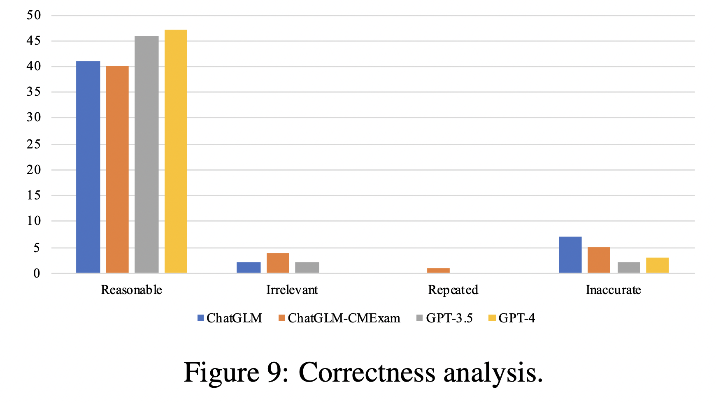
Quality of Model-generated Explanations
Irrelevant
Repeated
Inaccurate

Slide 7
Summary
CMExam (dataset)
Large (60k+ question-answer pairs)
Benchmark
High-coverage (20 models)
Multifaceted (Answer prediction + reasoning)
Reliable (Chinese National Medical Licensing Examination and other official resources)
Quantitative (Five additional annotations)
Qualitative (Corresponding explanation)

Slide 8
Github: https://github.com/williamliujl/CMExam
Email:

